Slide 1

Computer Networks
School of Computer Engineering and Technology (SCET)

Slide 2

Computer Networks
Teaching Scheme Credits: 3 + 1 = 4
Theory: 3 Hrs / Week Practical: 2 Hrs / Week
Course Objectives:
1. Knowledge:
i. To understand the fundamentals of networking and data communications.
ii. To understand network & data link layer protocols.
2. Skills: i. To learn network layer protocols.
3. Attitude:
i. To explore services offered by the transport layer.
ii. To understand protocols of the application layer
Course Outcomes:
On completion of course, students should be able to
1. Identify characterizing features of transmission techniques.
2. Recall and Demonstrate working of flow control & error control protocols.
3. Select routing protocol to Develop fully-functional simulation to simulate its working.
4. Define connection oriented & connectionless transport layer protocols & build working applications based on it.
5. Choose application layer protocol and make use of it in a suitable environment.

Slide 3
Pre-requisites
- Programming and Problem Solving

Slide 4
Syllabus
1 | Fundamentals of networking and data communication (9 Hrs) Analog Transmission: Analog-to-Analog conversion, Digital-to-Analog conversion, Digital Transmission: Digital-to-Digital conversion (line coding, block coding, scrambling), Analog-to-Digital conversion (Pulse Code Modulation, Delta Modulation) Types of Networks, Network Architectures, Network Topologies, Transmission media’s, Networking devices, OSI Model, TCP/IP Reference Model, Ethernet standards.
2 | Data Link Layer: (9 Hrs) Data Link Layer Services, Types of errors, Block coding, Error Control: Cyclic Redundancy Check (CRC) Code, Hamming Code, Checksum, sliding window Protocols: Selective Repeat (SR) & Go Back N (GBN), Channel allocation, Multiple Access Protocols: ALOHA, CSMA/CD, CSMA/CA, Ethernet Frame format.
3 | Network Layer (9 Hrs) Services, Internet Protocol: Ipv4 & Ipv6, Classful Addressing, Classless Addressing, CIDR, Subnetting, NAT, ARP, RARP ICMP, Routing Algorithms: Distance-Vector (DV) Routing, Link State (LS) Routing, Routing in Internet: RIP, OSPF, BGP
4 | Transport Layer (9 Hrs) Services, Multiplexing, demultiplexing. Sockets, UDP, RTP, TCP: Services, Features, Segment, TCP Connection (Three-Way Handshake), Flow control and buffering, Silly window syndrome, Congestion Control. Congestion Control (Leaky Bucket, Token Bucket), Quality of Service (QoS)
5 | Application Layer (9 Hrs) Dynamic Host Control Protocol (DHCP), Hypertext Transfer Protocol (HTTP), FTP, TELNET, SMTP: POP3, IMAP, MIME, Domain Name System (DNS), SNMP.

Slide 5
Guidelines for CCA and LCA
Examination Scheme
CCA Marks Distribution
Sr. No. | Examination Scheme | Marks
1. | Class Continuous Assessment (CCA) | 60
2. | Laboratory Continuous Assessment (LCA) | 50
3. | End Term Theory Examination | 40
Sr. No. | Class Continuous Assessment: (60 Marks) | Marks
1. | Assignments | 20
2. | Mid Term Exam | 20
3. | Active Learning | 20
Sr. No. | Laboratory Continuous Assessment: 50 | Marks
1. | Performance of Experiment | 30
2. | Oral Examination | 20
Term End Examination: 40 Marks

Slide 6
Lab Assignment
Design a simple network (LAN) with different topologies & test it using PING utility.
Analyze and test PCM modulation technique.
Design and configure a virtual LAN.
Write a program for error detection and correction codes using Hamming Codes
Write a program to implement subnetting to find subnet mask
Implement Static and Dynamic NAT Configuration with Packet Tracer
Set up a network - configure interfaces, IP addresses and routing protocols (RIP, OSPF, EIGRP, BGP).
Write a C program for wired network using TCP socket to demonstrate a) Chat Application (50% Students) b) Mathematical operations. (Remaining 50% Students) Show packet captured traces using Wireshark Packet Analyzer Tool.
UDP Socket Programming: (Language: C/C++/Python/Java)/ Write a C program for wired network using UDP socket to perform any one of the following operations.
a. String Conversion from UpperCase to LowerCase. (50% Students)
b. Reverse the String. (Remaining 50% Students) Show packet captured traces using Wireshark Packet Analyzer Tool.
Configure network using Dynamic Host Configuration Protocol (DHCP), DNA and Web server Use Ping utility to
test connectivity.

Slide 7
Unit I: Fundamentals of networking and data communication
Analog Transmission: Analog-to-Analog conversion, Digital-to-Analog conversion, Digital Transmission: Digital-to-Digital
conversion (line coding, block coding, scrambling), Analog-to-Digital conversion (Pulse Code Modulation, Delta Modulation)
Types of Networks, Network Architectures, Network Topologies,
Transmission media’s, Networking devices, OSI Model, TCP/IP
Reference Model, Ethernet standards.

Slide 8

Text book
Computer Networks
Tanenbaum A. S.
Pearson Education
5th Edition

Slide 9
Learning Resources
Text Books:
1. Behrouz A. Forouzan, ‘Data Communications and Networking’, 5th Edition, McGrawHill Publishing Company,
ISBN 978-0-07-337622-6
2. Tanenbaum A. S., ‘Computer Networks’, Pearson Education, 5th Edition, ISBN-978-0-13-212695-3
Reference Books:
1. James F. Kurose and Keith W Ross ‘Computer Networking, A Top-Down Approach’, 5th Edition, Pearson
Education, ISBN- 978-81-317-9054-0
2. W. Richard Stevens, Unix Network Programming, The Sockets Networking API, Vol 1, 3rd Edition, PHI
Learning Pvt. Ltd.
Supplementary Reading:
1. William Stallings, ‘Data and Computer Communications’, 6th Edition, Prentice Hall of India Pvt.

Slide 10
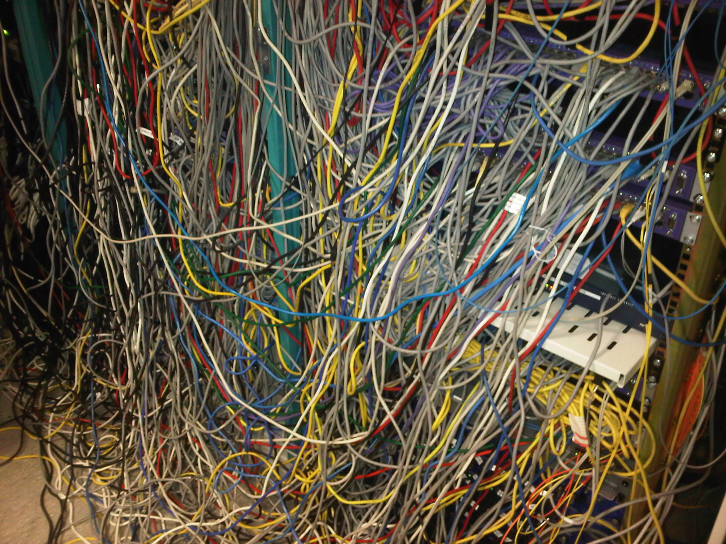

Slide 11
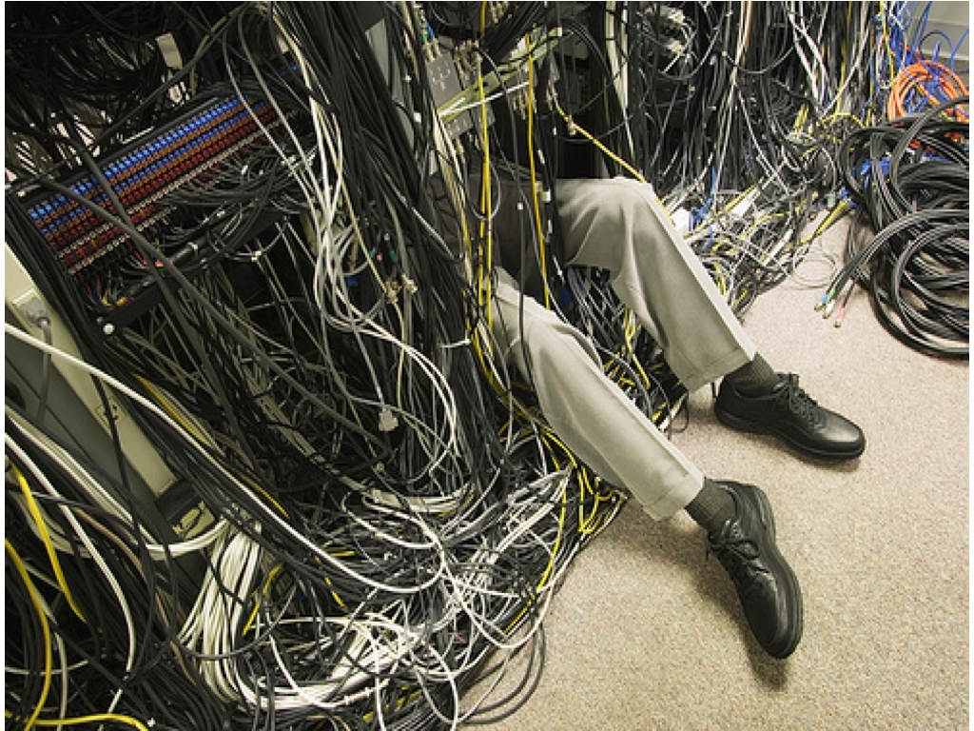

Slide 12
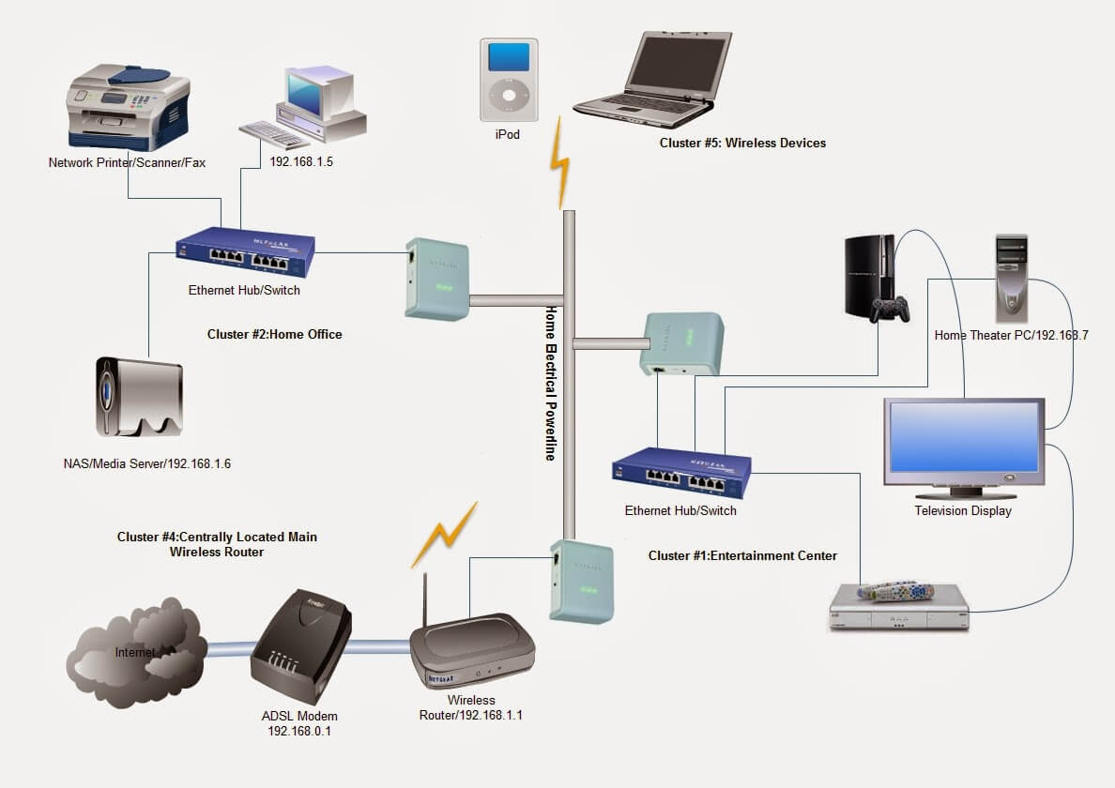

Slide 13
Introduction
Data Communications Telecommunication – means communication at a distance. (“tele”, greek word for “far”)
Data - refers to information presented in whatever form is agreed upon by the parties creating and using the data
Data Communication - exchange of data between two devices via some form of transmission medium such as a wire cable
Data is a collection of facts. Information is how you understand those facts in context
Data is unorganized, while information is structured or organized
Data is not typically useful on its own, but information is

Slide 14
Analog and Digital Data
The term analog data refers to information that is continuous
Analog data, such as the sounds made by a human voice, take on continuous values can be captured by a microphone and converted to an analog signal or sampled and converted to a digital signal
Digital data refers to information that has discrete states
Digital data take on discrete values. For example, data are stored in the memory as 0s and 1
They can be converted to a digital signal or modulated into an analog signal for transmission across a medium

Slide 15
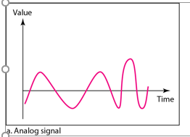
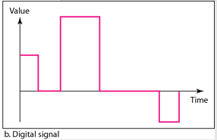
Analog and Digital Signals
Signal - A signal is an electromagnetic or electrical current that is used for carrying data from one system or network to another
An analog signal is any continuous signal for which the time varying feature of the signal is a representation of some other time varying quantity i.e., analogous to another time varying signal.
A digital signal is a signal that represents data as a sequence of discrete values; at any given time it can only take on one of a finite number of values.
Discrete value 1 and 0

Slide 16
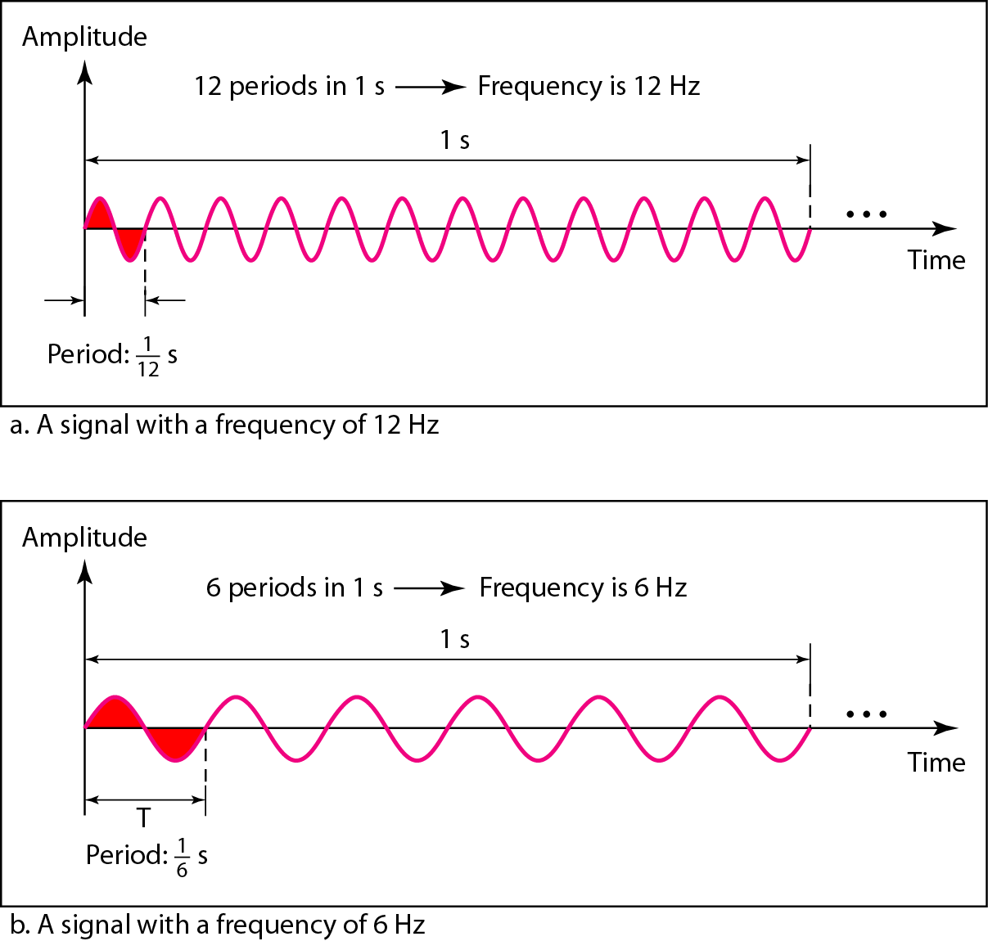
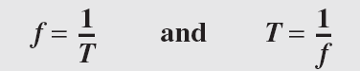
Period and Frequencies
Period refers to the amount of time, in seconds, a signal needs to complete 1 cycle.
Frequency refers to the number of periods in 1 s
Frequency and period are the inverse of each other.

Slide 17
Period and Frequencies
The power we use at home has a frequency of 60 Hz. The period of this sine wave can be determined as follows:
The period of a signal is 100 ms. What is its frequency in kilohertz?
Solution
First we change 100 ms to seconds, and then we calculate the frequency from the period (1 Hz = 10⁻³ kHz).

Slide 18
Conversion Techniques
Data | Signal | Technique
Analog | Analog | Modulation
Digital | Analog
Analog | Digital | Encoding
Digital | Digital

Slide 19
Modulation
Modulation is the process of altering one or more properties of a periodic waveform known as a carrier signal with respect to the modulation signal, which contains information to be transmitted
Modulation is performed by the device known as a modulator, and this technique is mainly used to overcome the interference of the signal. Modulation techniques typically aid in long-distance communication
Modulation is of two types
1. Analog Modulation
2. Digital modulation

Slide 20
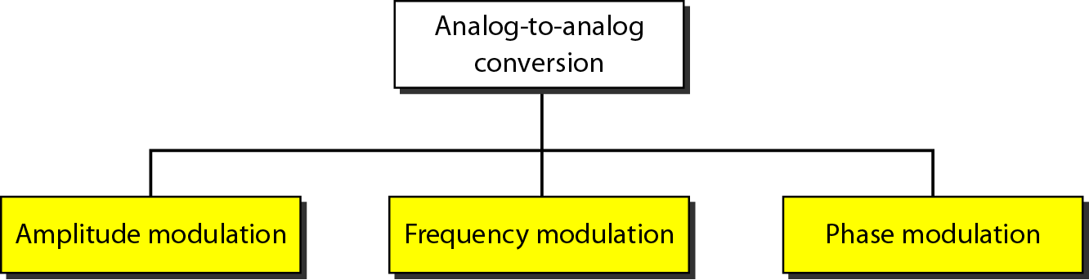
Types of Analog-to-Analog modulation

Slide 21
Analog to Analog Conversion
Types of modulation (Analog Modulation Schemes)
Amplitude Modulation: Amplitude is varied keeping frequency and phase constant
Frequency Modulation: Frequency is varied keeping amplitude and phase constant
Phase Modulation: Phase is varied keeping amplitude and frequency constant

Slide 22
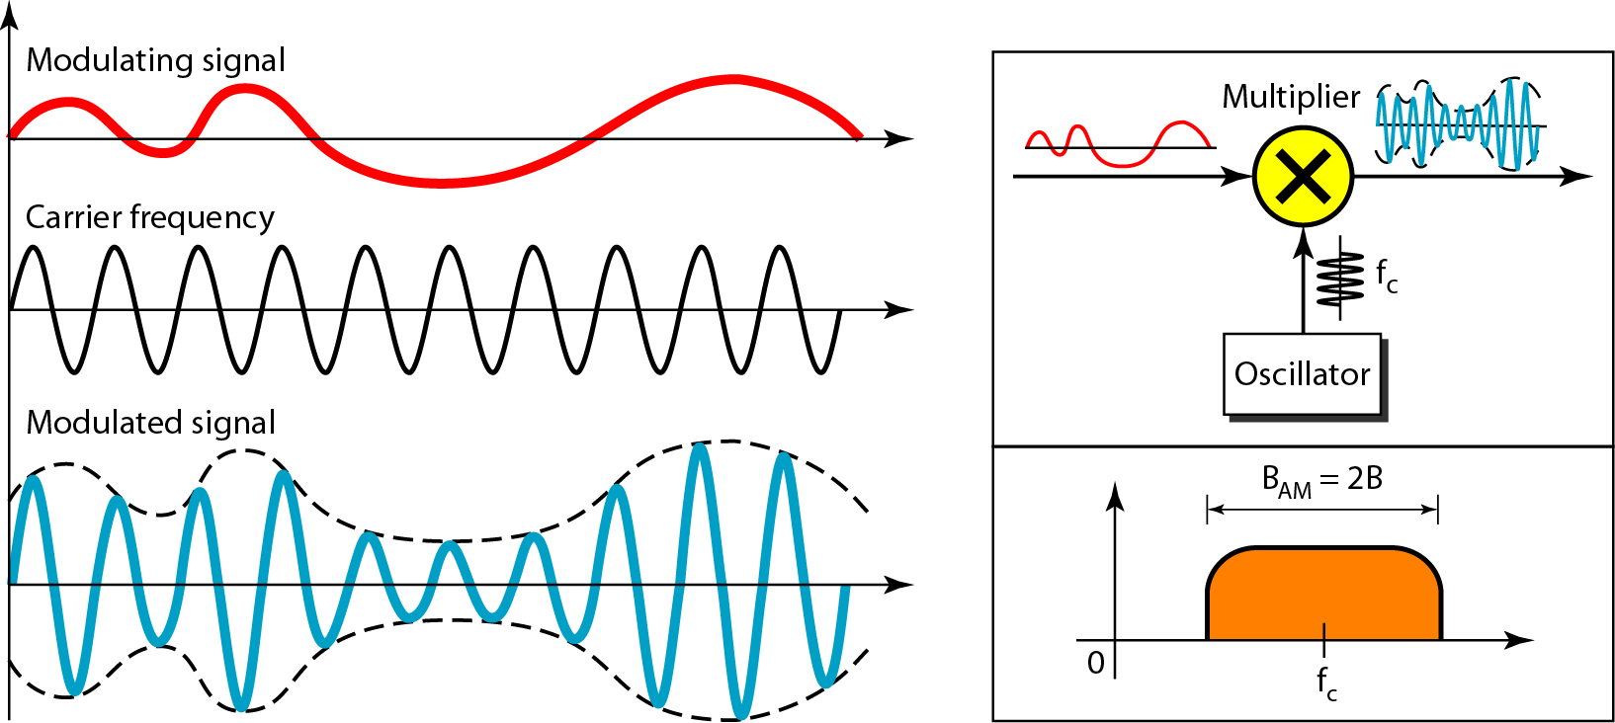
Amplitude Modulation
The total bandwidth required for AM can be determined from the bandwidth of the audio signal: B_{AM} = 2B.

Slide 23
Advantages and disadvantages of AM
Advantages of Amplitude Modulation
Amplitude Modulation is easier to implement
The components used in building the AM transmitter and AM receiver are very cheap
It can be demodulated using a circuit consisting of very few components
Disadvantages of Amplitude Modulation
Poor Performance due to noise
Inefficient use of transmitter power
It is not efficient in terms of its use of bandwidth, requiring a bandwidth equal to twice that of the highest frequency.
Applications of Amplitude Modulation
Broadcast Transmissions
Air-band radio
Single sideband
Quadrature amplitude modulation

Slide 24
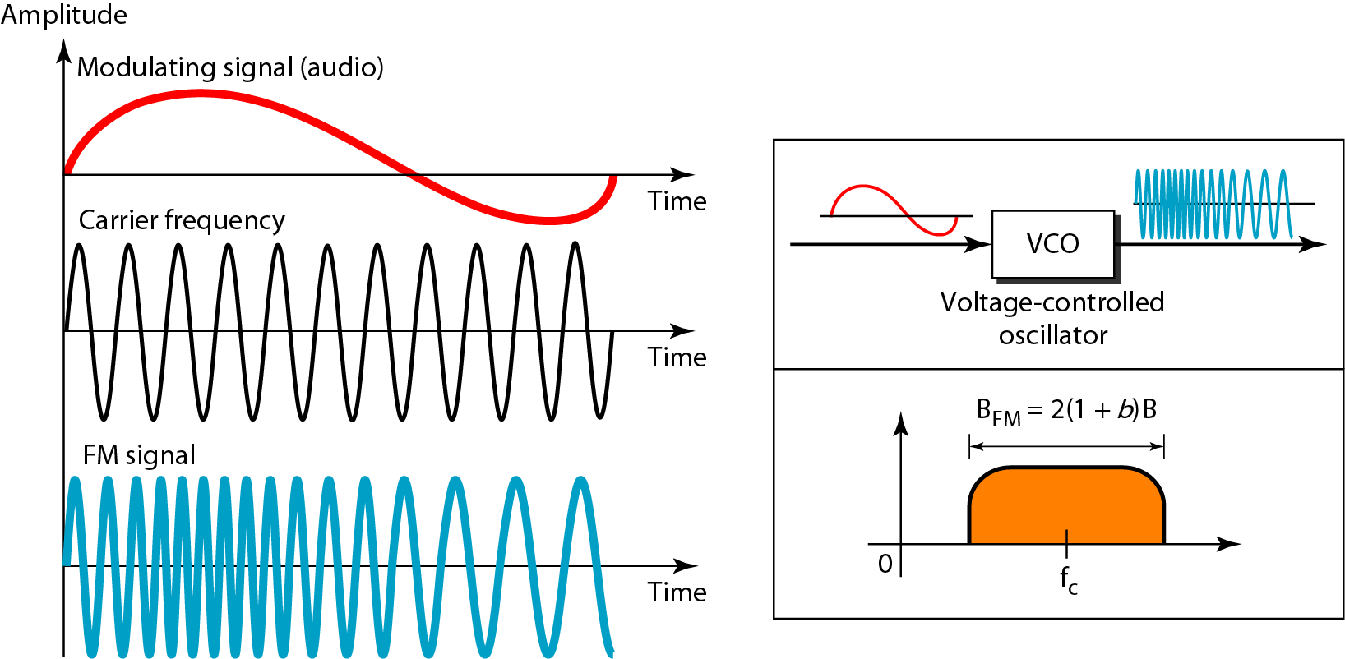
Frequency Modulation
Frequency modulation is the process by which the frequency of a carrier signal changes with respect to the modulating signal.
The total bandwidth required for FM can be determined from the bandwidth of the audio signal: B_{FM} = 10B.

Slide 25
Advantages and disadvantages of FM
Advantages of Frequency Modulation
The amplitude of the frequency-modulated wave does not get affected.
Large decrease in noise, hence increase in the signal to noise ratio.
Noise may reduce by increasing the frequency deviation.
Frequency allocation allows for a guard band which reduces adjacent channel interference.
It operates in a very high frequency called VHF.
Disadvantages of Frequency Modulation
FM cannot cover large areas.
Transmitting and receiving equipment of frequency modulation is complex and expensive.
A much wider channel typically 200 kHz is required by FM..
The antennas for FM need to be closely placed for better signals.
Applications of Frequency Modulation
Telemetry, radar and seismic prospecting, EEG monitoring
It is used in radio broadcasts
It is used for audio frequency synthesis.

Slide 26
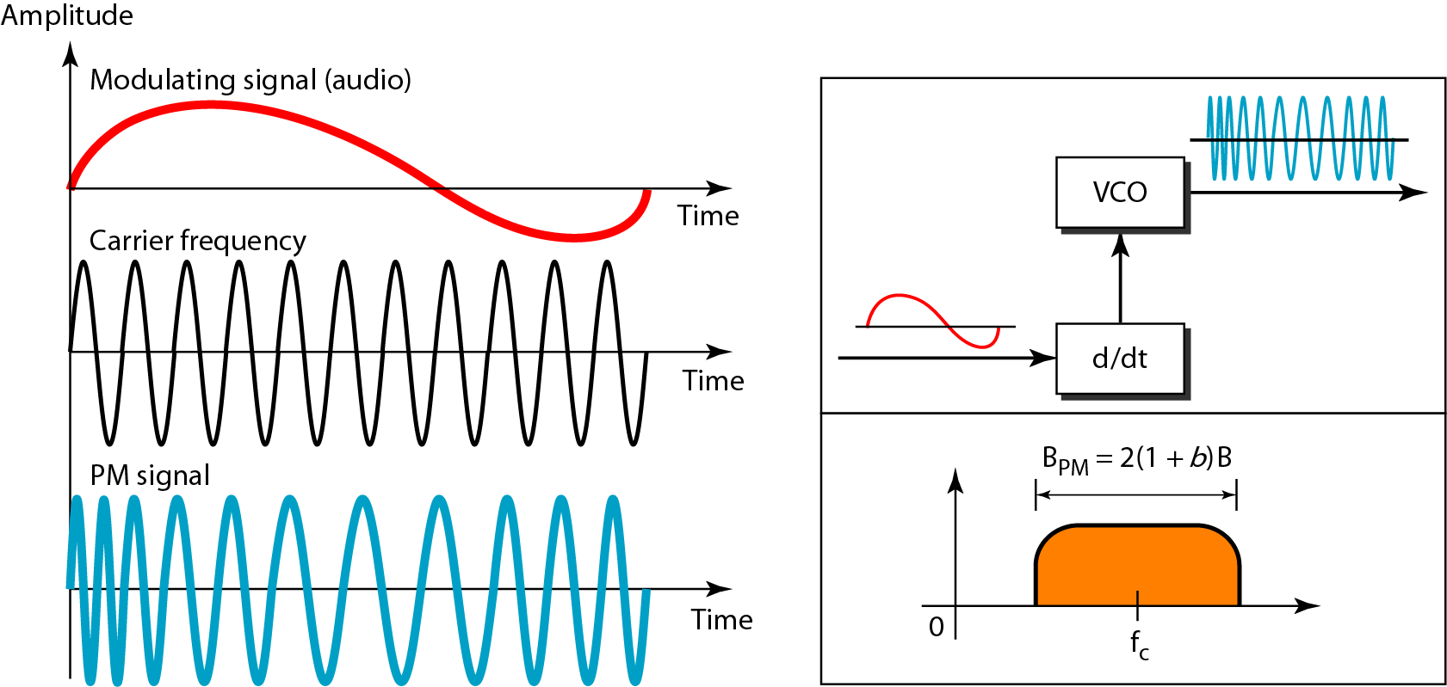
Phase Modulation
The total bandwidth required for PM can be determined from the bandwidth and maximum amplitude of the modulating signal: B_{PM} = 10B.

Slide 27
Advantages and disadvantages of Phase Modulation
Advantages of Phase Modulation
Phase modulation (PM) is a simple contrasted to Frequency modulation (FM)
It has a higher transmitter efficiency.
It has a higher noise immunity.
Disadvantages of Phase Modulation
The system cost is quite expensive
Phase ambiguity comes if we exceed its modulation index pi radian(180 degree).
we need frequency multiplier to increase phase modulation index.
Applications of Phase Modulation
Wireless technologies such as GSM, Satellite television, and Wi-Fi.
widely used in the transmission of radio waves satellite transmission system
Used in digital synthesizers for generating waveform and signal

Slide 28
Comparison of AM and FM
Amplitude Modulation | Frequency Modulation
In amplitude modulation, the frequency and phase remain the same | In frequency modulation amplitude and phase remain the same
Its modulation index varies from 0 to 1 | Its modulation index is always greater than one
It has only two sidebands | It has an infinite number of sidebands
It has simple circuit | It has complex circuit
The amplitude of the carrier wave is modified in order to send the data or information | The frequency of the carrier wave is modified in order to send the data or information
It requires low bandwidth in the range of 10 kHz | It requires high bandwidth in the range of 200 kHz
In AM received signal is of low quality | In FM received signal is of high quality
It operates in the medium frequency (MF) and high frequency (HF) | It operates in the very high frequency
It has poor sound quality | It has better sound quality

Slide 29
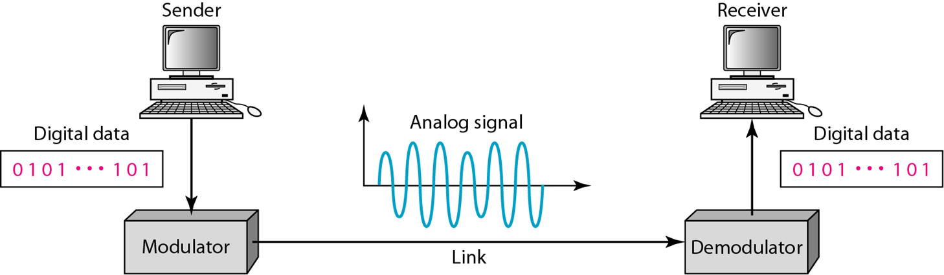
Digital to Analog Conversion
Digital-to-analog conversion is the process of changing one of the characteristics of an analog signal based on the information in digital data.

Slide 30
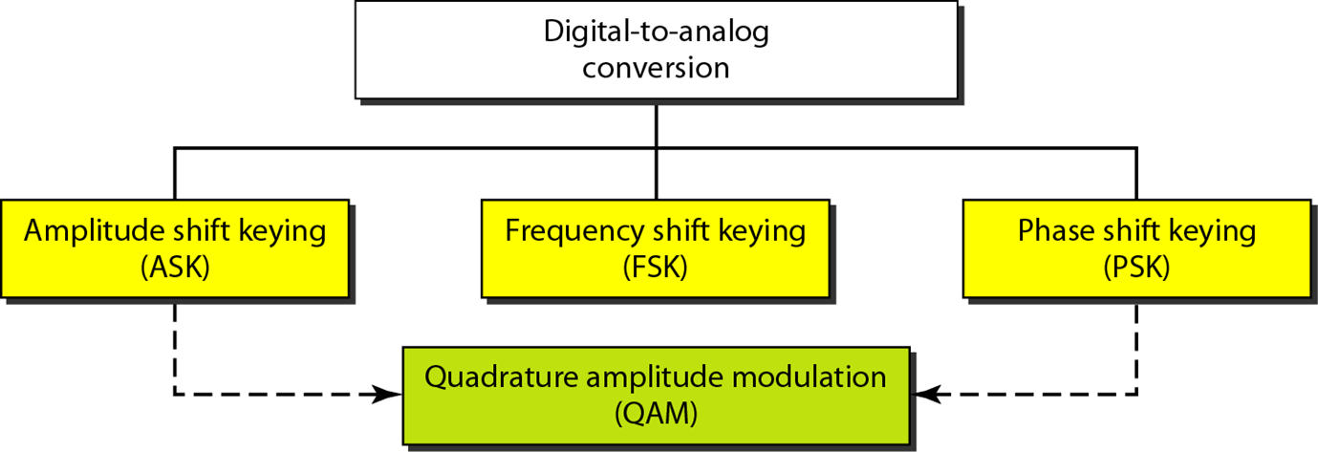
Types of Digital to Analog Conversion
Amplitude Shift Keying
Frequency Shift Keying
Phase Shift Keying
Quadrature Amplitude Modulation

Slide 31
Amplitude Shift Keying
Definition: A digital modulation technique in which the amplitude of the carrier wave is altered according to the modulating signal (bitstream) is known as Amplitude Shift Keying (ASK). It is the easiest and straightforward digital modulation scheme.
ASK is sometimes known as On-Off keying because the carrier wave swings between 0 and 1 according to the low and high level of input signal respectively.

Slide 32
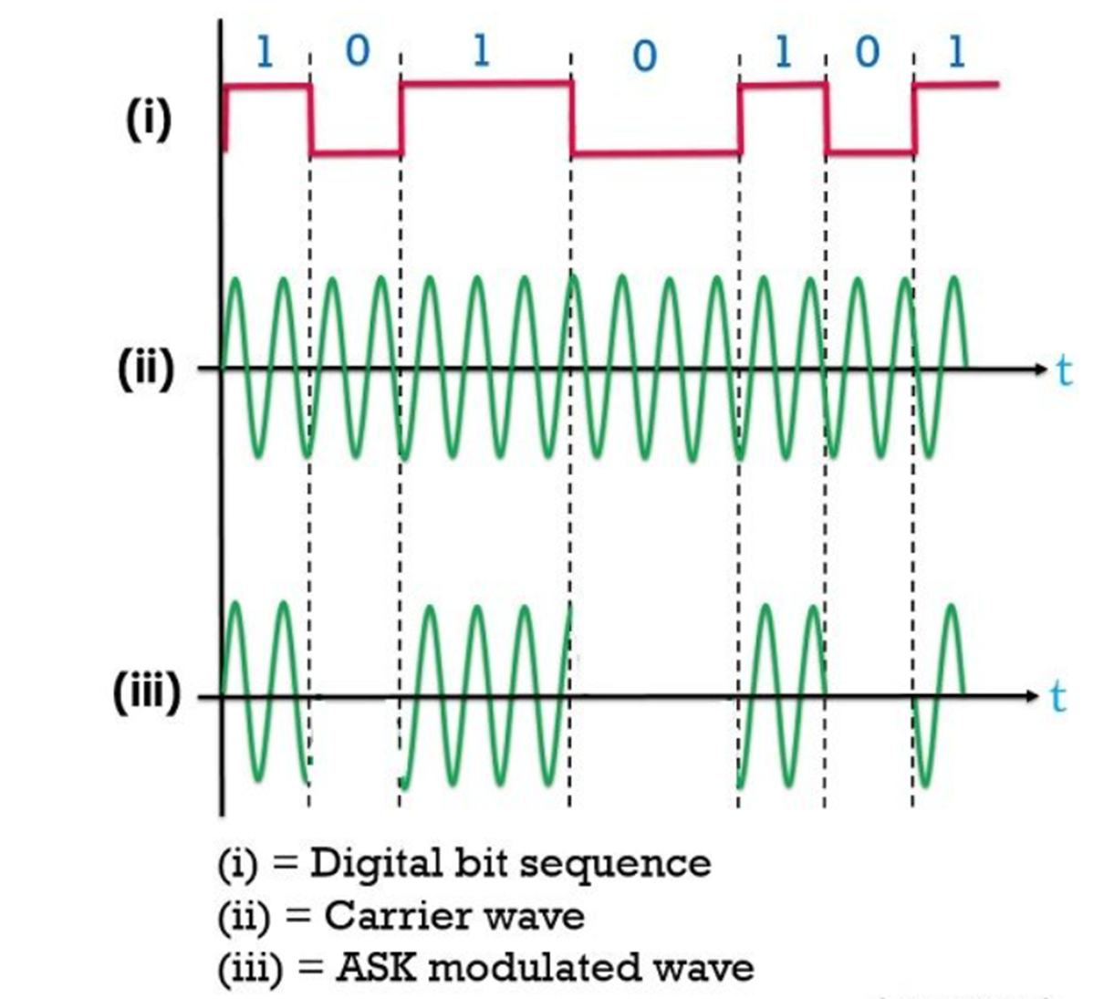
Amplitude Shift Keying

Slide 33
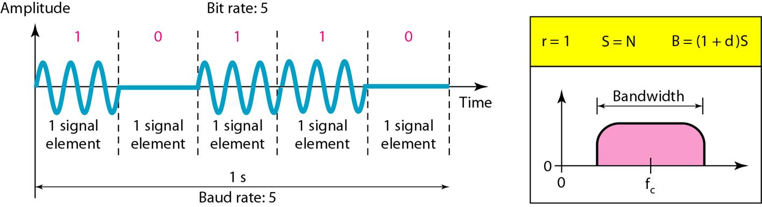
Bandwidth for ASK

Slide 34
Frequency Shift Keying
Definition: A digital modulation technique that allows data transmission by changing the frequency of the carrier wave according to the digital modulating signal is known as frequency shift keying (FSK).
It is the most straightforward and efficient digital signal transmission scheme.

Slide 35
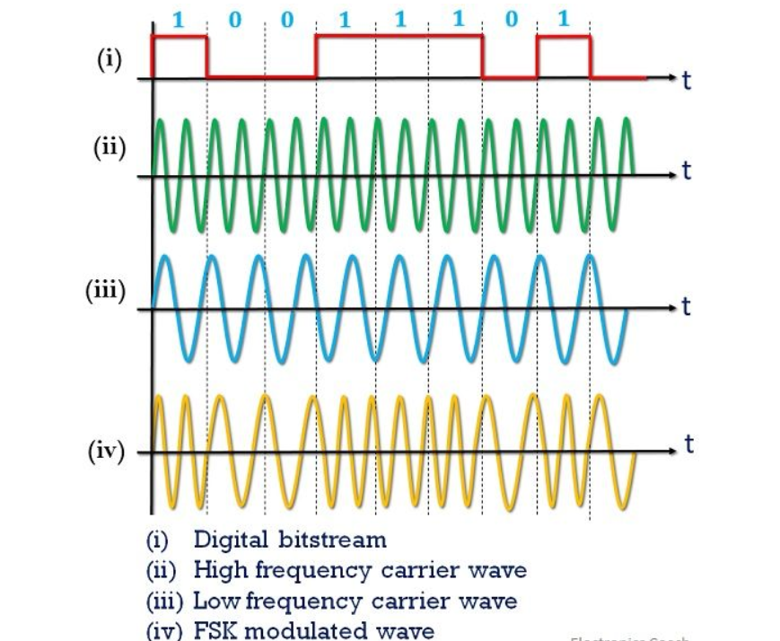
Frequency Shift Keying

Slide 36
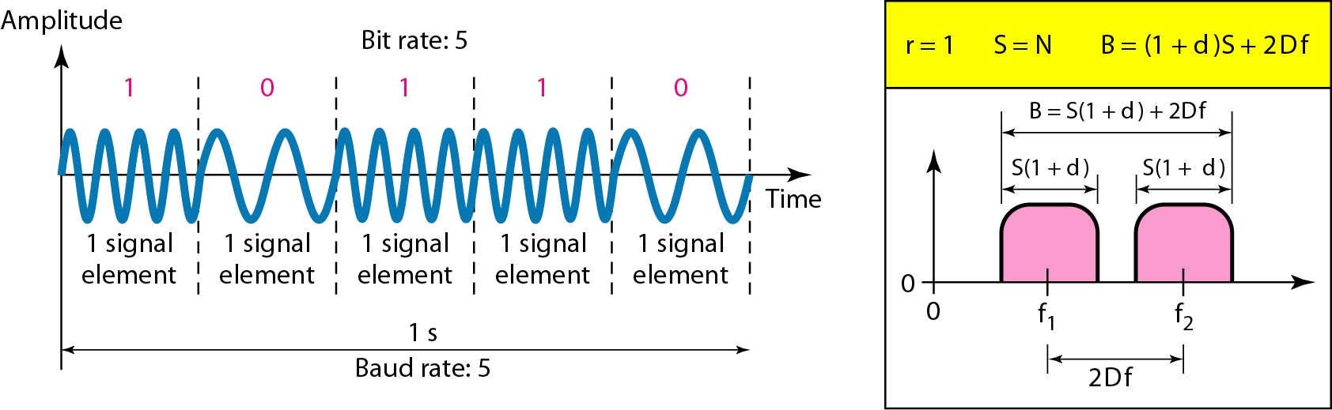
Bandwidth of Frequency Shift Keying
d = 1 for BFSK

Slide 37

Phase Shift Keying
Definition: A digital modulation technique that transmits data by varying the phase of the carrier wave in accordance with the digital modulating signal, is called Phase Shift Keying (PSK).
The easiest form of PSK is BPSK i.e., binary phase shift keying. However, PSK can be extended to 4 level and 8 level PSK that totally depends on the need of the system.

Slide 38
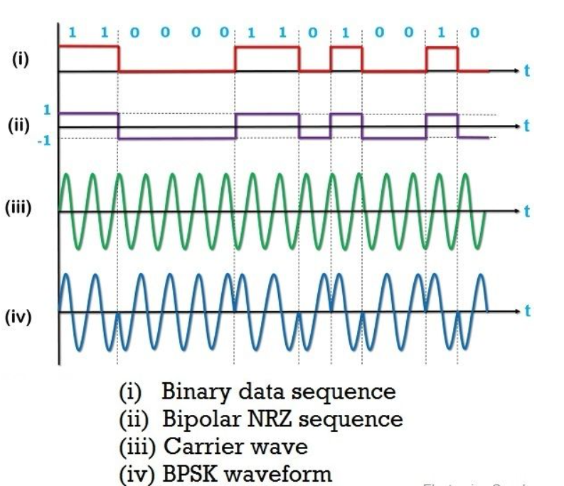
Phase Shift Keying
The Simplest PSK is binary PSK, in which we have only two signal element, one with a phase of 0⁰, and the other with a phase 180⁰
Binary PSK is as simple as binary ASK with one big advantage – it is less susceptible to noise.
PSK is superior to FSK because we do not need two carrier signals
When the bit sequence changes from 0 to 1 then we noticed a positive phase change whereas, when the bit sequence changes from 1 to 0 then a negative change of phase is noticed.

Slide 39
Digital-to-Digital Conversion
Represent digital data by using digital signals.
The conversion involves three techniques:
Line Coding
Block Coding
Scrambling

Slide 40
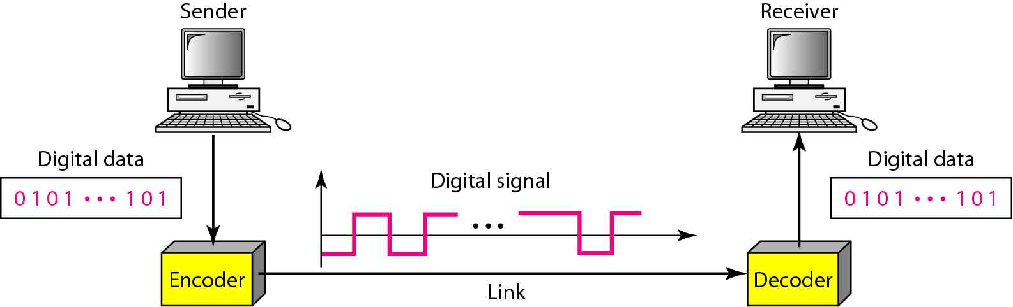
Line Coding
Converting a string of 1’s and 0’s (digital data) into a sequence of signals that denote the 1’s and 0’s.
For example a high voltage level (+V) could represent a “1” and a low voltage level (0 or -V) could represent a “0”.

Slide 41
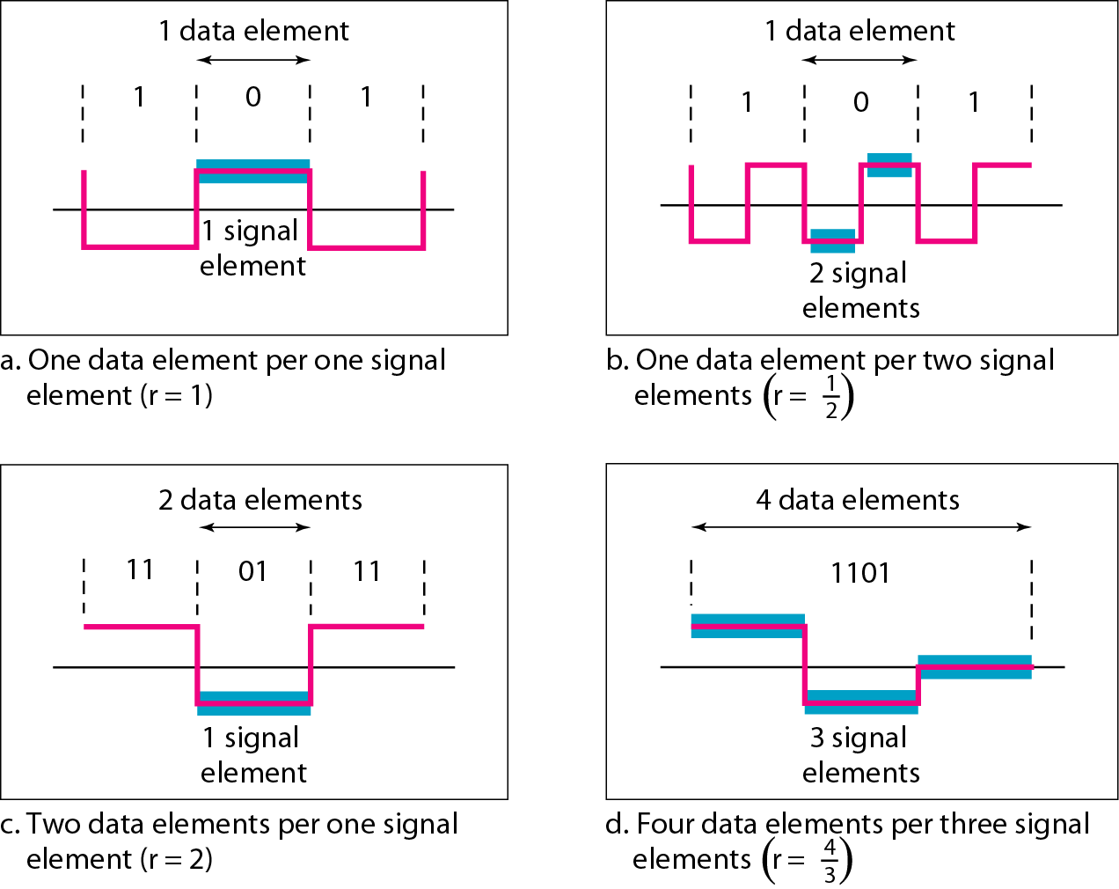
Relationship between data rate and signal rate
Data rate = the number of bits sent per sec - bps.
The baud or signal rate can be expressed as:
S = c x N x 1/r bauds
where N is data rate
c is the case factor (worst, best & avg.)
r is the ratio between data element & signal element

Slide 42
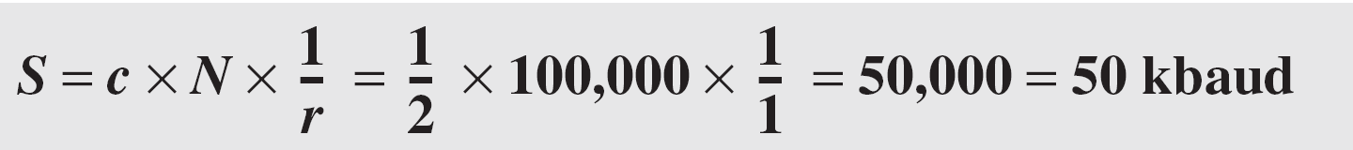
Example - Signal Rate
A signal is carrying data in which one data element is encoded as one signal element ( r = 1). If the bit rate is 100 kbps, what is the average value of the baud rate if c is between 0 and 1? Assume that the average value of c is 1/2

Slide 43
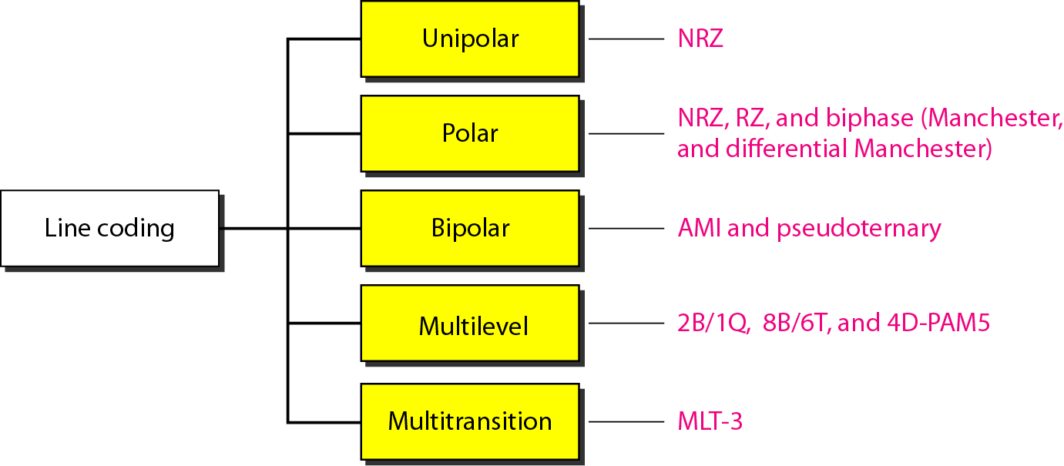
Line Coding Schemes

Slide 44
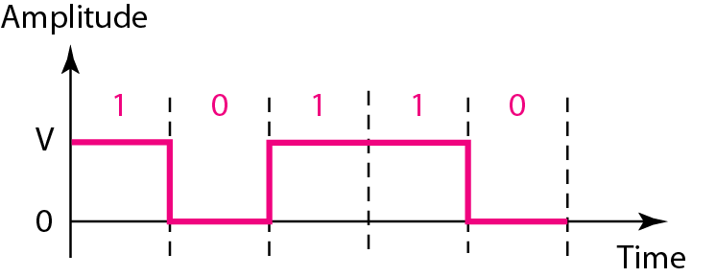
Unipolar
Signal levels are on one side of the time axis - either above or below
NRZ - Non Return to Zero scheme is an example of this code. The signal level does not return to zero during a symbol transmission.
It has no synchronization or any error detection. It is simple but costly in power consumption.

Slide 45
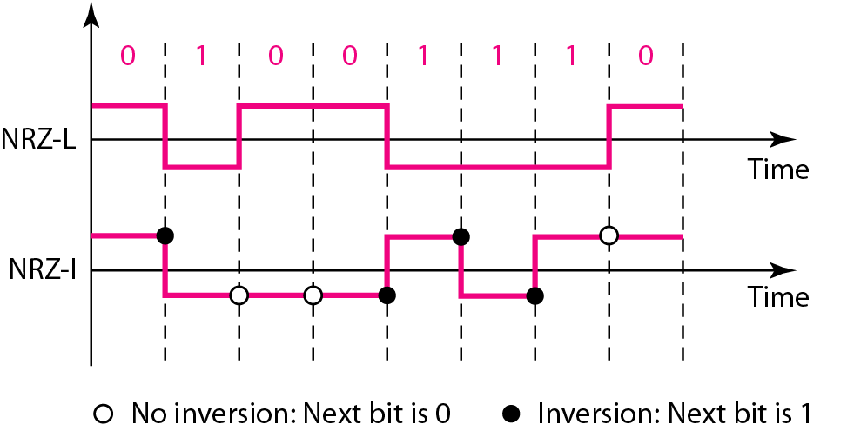
Polar
Non-Return-to-Zero (NRZ)
The voltages are on both sides of the time axis.
Polar NRZ scheme can be implemented with two voltages. E.g. +V for 1 and -V for 0.
There are two versions:
NZR - Level (NRZ-L) - positive voltage for one symbol and negative for the other
NRZ - Inversion (NRZ-I) - the change or lack of change in polarity determines the value of a symbol. E.g. a “1” symbol inverts the polarity a “0” does not.

Slide 46
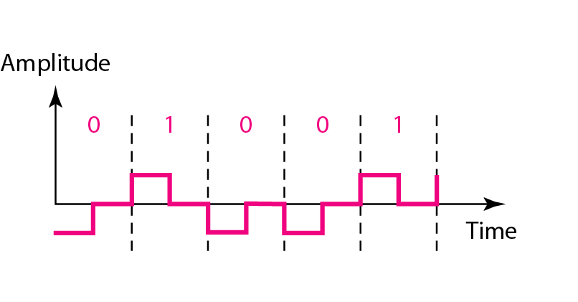
Polar
Return-to-Zero (RZ)
This scheme uses three voltage values. +, 0, -.
Each symbol has a transition in the middle. Either from high to zero or from low to zero.
This scheme has more signal transitions (two per symbol) so requires a wider bandwidth.

Slide 47
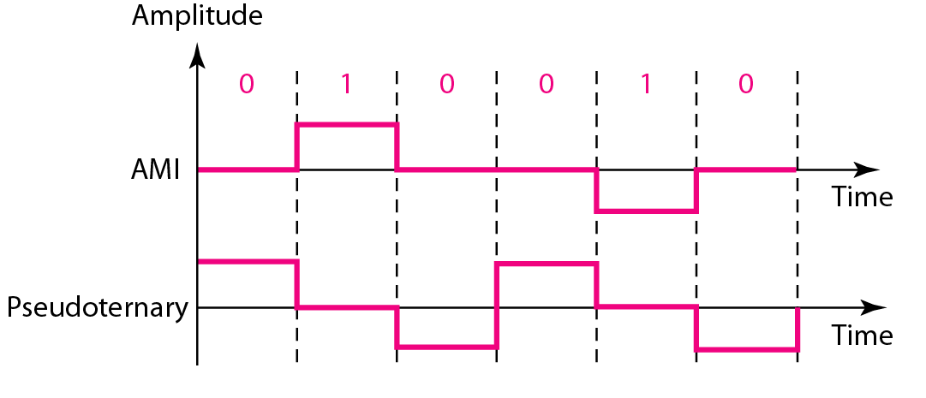
Bipolar
Code uses 3 voltage levels: - +, 0, -, to represent the symbols (note not transitions to zero as in RZ).
Voltage level for one symbol is at “0” and the other alternates between + & -.
Bipolar Alternate Mark Inversion (AMI) - the “0” symbol is represented by zero voltage and the “1” symbol alternates between +V and -V.
Pseudoternary is the reverse of AMI.

Slide 48
Block Coding
A technique of sending data in a set of sequence.
Block coding is done in three steps:
Division,
Substitution and
Combination.
Need to add redundant bits for padding, error checking

Slide 49
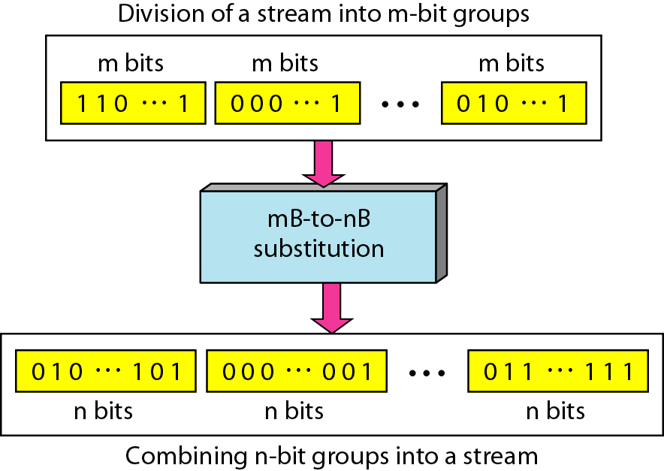
Block Coding

Slide 50
Scrambling
Earlier coding schemes are not suitable for long distance because of DC component
Scrambling is a technique to avoid long sequence of 0’s used to create a sequence of bits that has the required bandwidth for transmission - self clocking, no low frequencies, no wide bandwidth.
It is implemented at the same time as encoding, the bit stream is created on the fly.
It replaces ‘unfriendly’ runs of bits with a violation code that is easy to recognize.

Slide 51
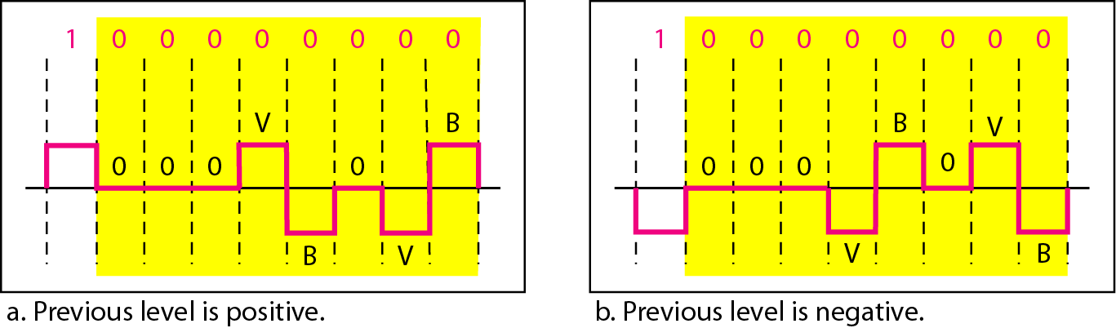
Scrambling

Slide 52
Analog-to-Digital Conversion
A digital signal is superior to an analog signal
it is more robust to noise and can easily be recovered, corrected and amplified.
For this reason, it is better to change an analog signal to digital data.
In this section we describe two techniques,
Pulse Code Modulation and
Delta Modulation

Slide 53
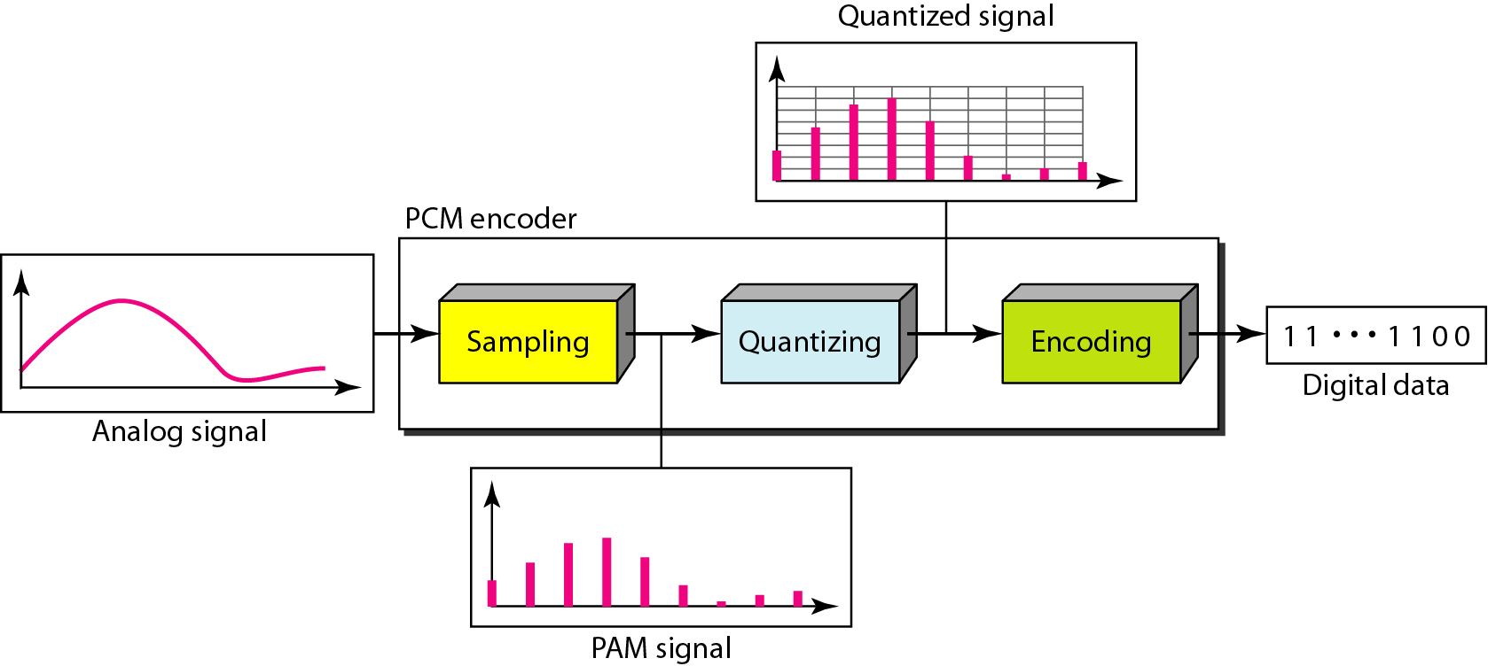
Pulse Code Modulation (PCM)
PCM consists of three steps to digitize an analog signal:
Sampling
Quantization
Binary Encoding

Slide 54
Sampling
Analog signal is sampled every T_{S} secs.
There are 3 sampling methods:
Ideal - an impulse at each sampling instant
Natural - a pulse of short width with varying amplitude
Flattop - sample and hold, like natural but with single amplitude value

Slide 55
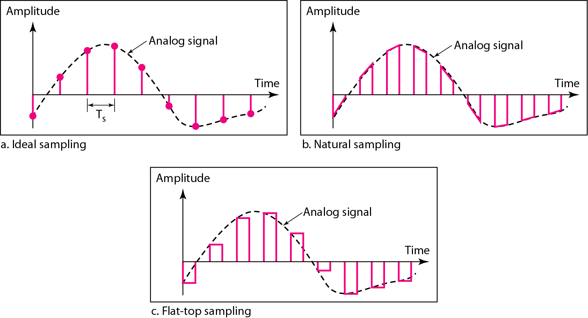
Sampling Methods

Slide 56
Quantization
Sampling results in a series of pulses of varying amplitude values ranging between two limits: a min and a max.
The amplitude values are infinite between the two limits.
We need to map the infinite amplitude values onto a finite set of known values.

Slide 57
Quantization Steps
Assume we have a voltage signal with amplitudes V_{min}=-20V and V_{max}=+20V.
We want to use L=8 quantization levels.
Zone width Δ = (20 - -20)/8 = 5
The 8 zones are: -20 to -15, -15 to -10, -10 to -5, -5 to 0, 0 to +5, +5 to +10, +10 to +15, +15 to +20
The midpoints are: -17.5, -12.5, -7.5, -2.5, 2.5, 7.5, 12.5, 17.5

Slide 58
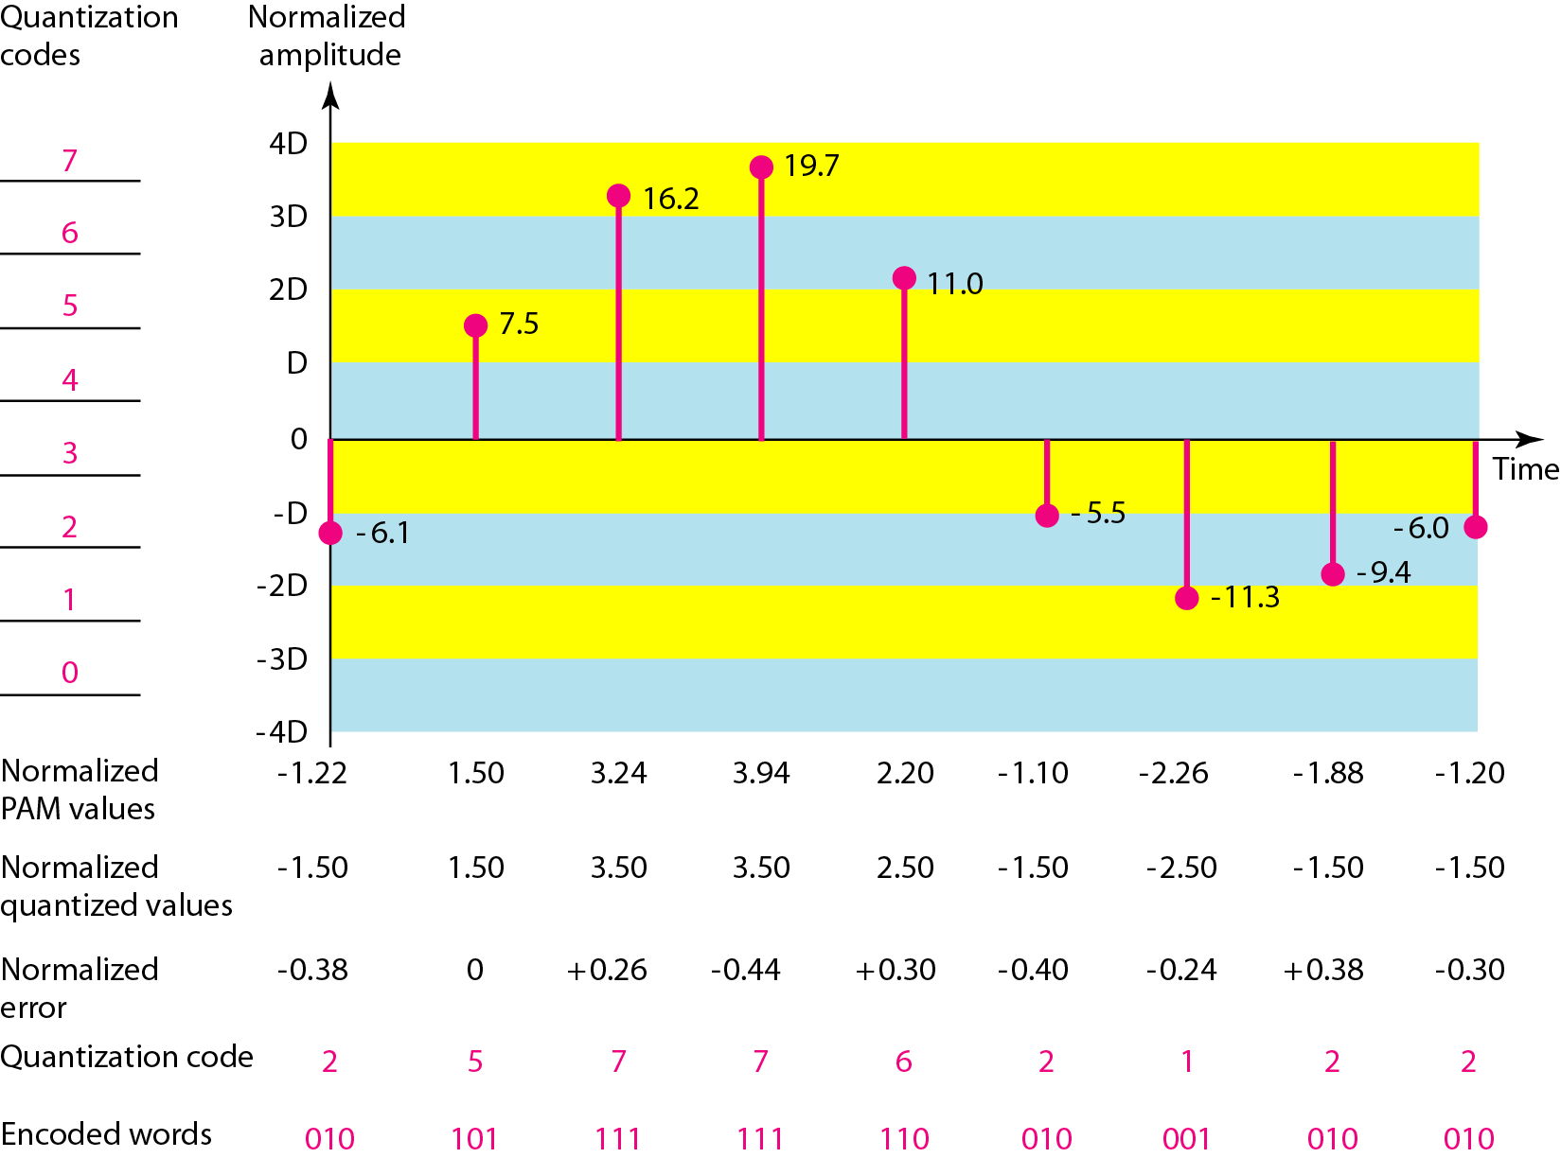
Binary Encoding

Slide 59
Binary Encoding
Each zone is then assigned a binary code.
The number of bits required to encode the zones, or the number of bits per sample as it is commonly referred to, is obtained as follows:
n_{b} = log₂ L
Given our example, n_{b} = 3
The 8 zone (or level) codes are therefore: 000, 001, 010, 011, 100, 101, 110, and 111
Assigning codes to zones:
000 will refer to zone -20 to -15
001 to zone -15 to -10, etc.

Slide 60
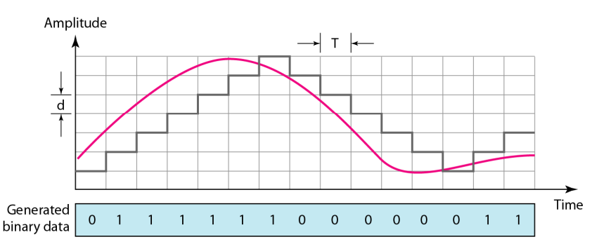
Delta Modulation (DM)
PCM is a very complex technique.
The simplest is delta modulation.
PCM finds the value of the signal amplitude for each sample;
DM finds the change from the previous sample.
Note that there are no code words here, bits are sent one after another.
The process of delta modulation

Slide 61
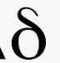
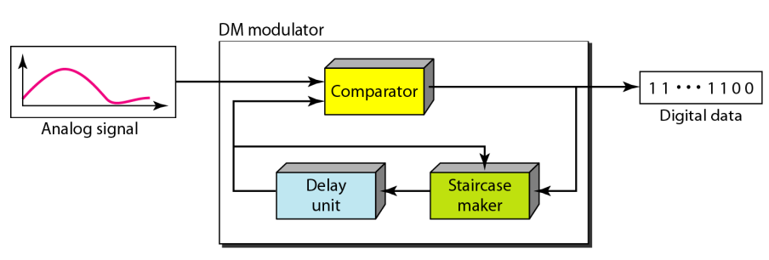
Delta Modulation Components
Modulator:
The modulator is used at the sender site to create a stream of bits from an analog signal.
The process records the small positive or negative changes, called delta . .
If the delta is positive, the process records a 1; if it is negative, the process records a 0.
Delta Modulation Components

Slide 62
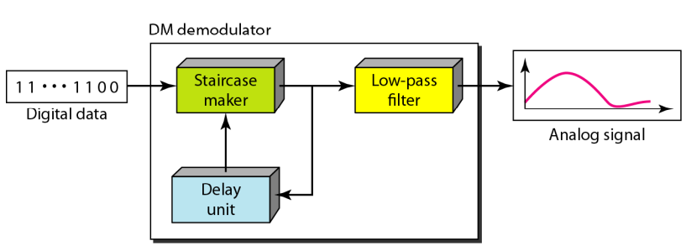
Demodulator
The demodulator takes the digital data and, using the staircase maker and the delay unit, creates the analog signal. The created analog signal, however, needs to pass through a low-pass filter for smoothing.
Delta demodulation components

Slide 63
Unit-I
Introduction and Medium Access Control

Slide 64
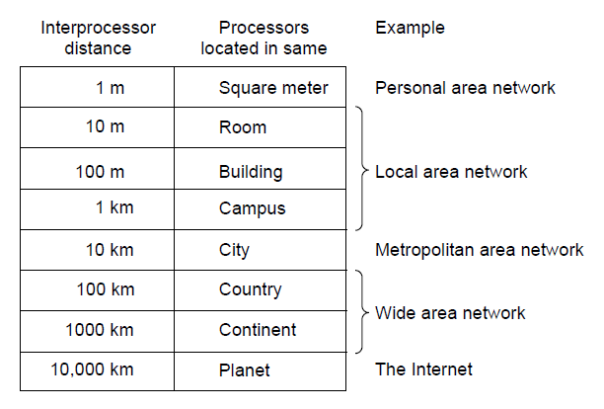
Types of Networks

Slide 65
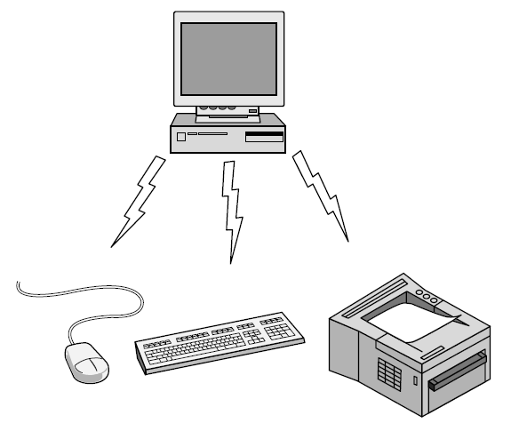
Personal Area Network (PAN)
Bluetooth PAN configuration

Slide 66
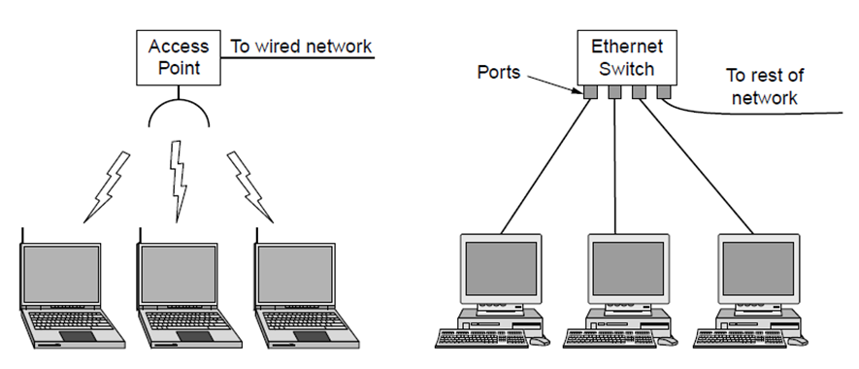
Local Area Network (LAN)
Wireless and Wired LAN
(a) 802.11 (b) Switched Ethernet

Slide 67
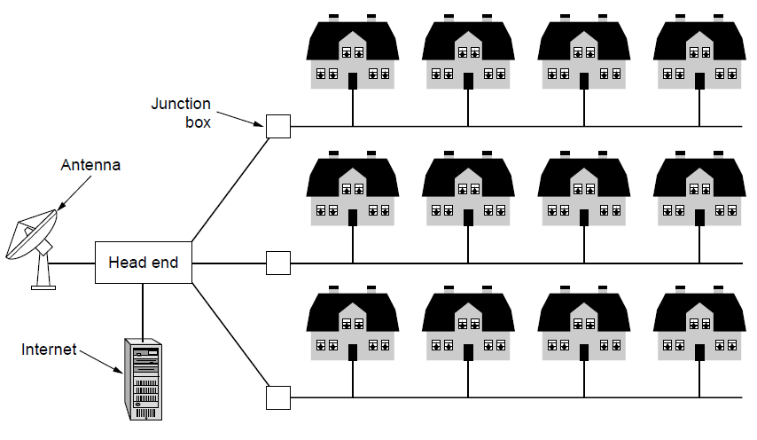
Metropolitan Area Network(MAN): based on cable TV

Slide 68
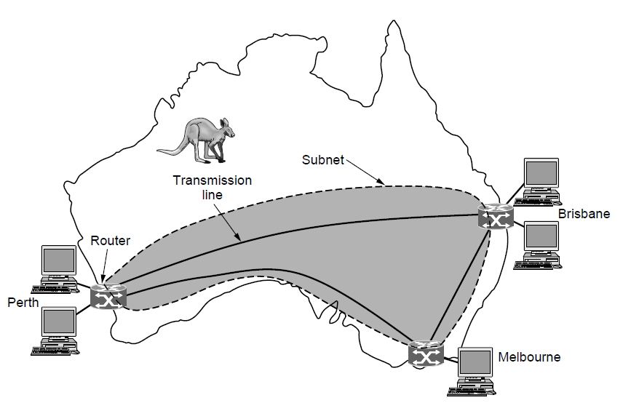
Wide Area Network (WAN)
WAN: connects three branch offices in Australia

Slide 69
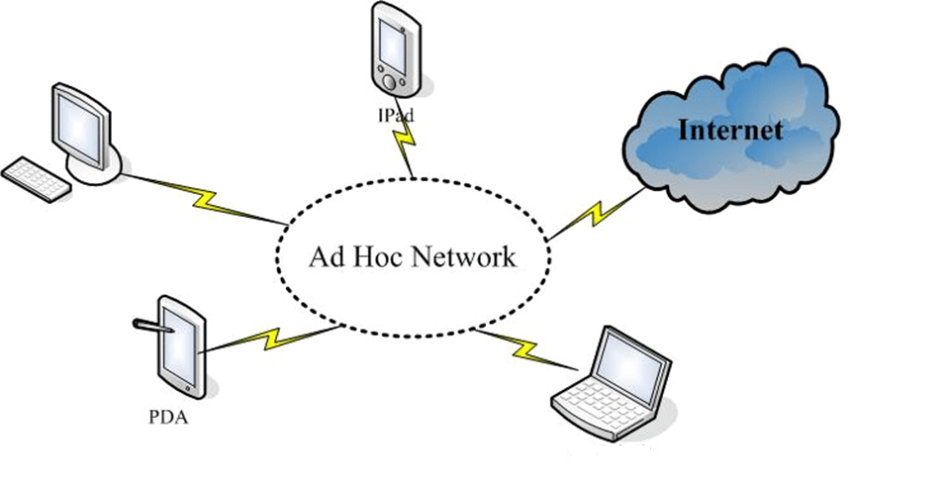
Ad-hoc Network

Slide 70
Network Architectures
Client-Server
Peer-to-Peer
Distributed Network
Software Define Network

Slide 71
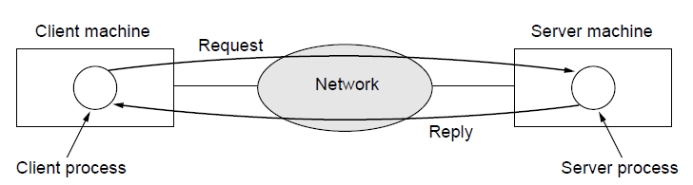
Client-Server Model
Client-server model: involves requests and replies

Slide 72
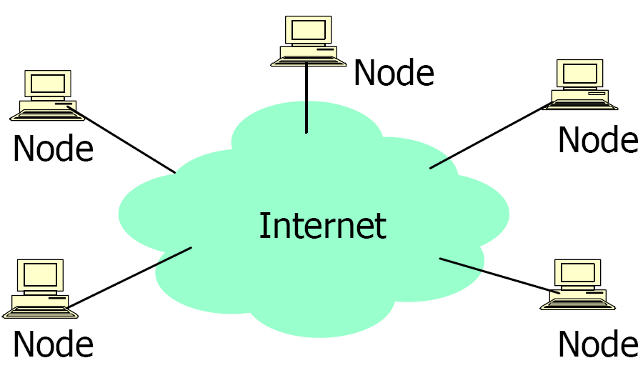
Peer-to-Peer Architecture
All nodes acts as a clients and servers
Provides and consume data
Any node can initiate a connection
No centralized data source
The ultimate form of democracy on the Internet
The ultimate threat to copy-right protection on the Internet

Slide 73
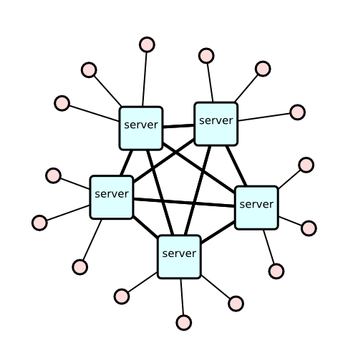
Distributed Network
Enterprise IT infrastructure resources are divided over a number of networks, processors and intermediary devices

Slide 74
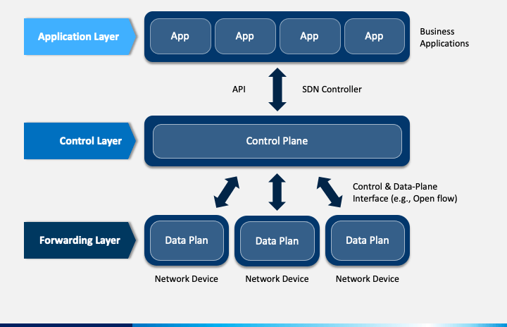
Software Define Network

Slide 75
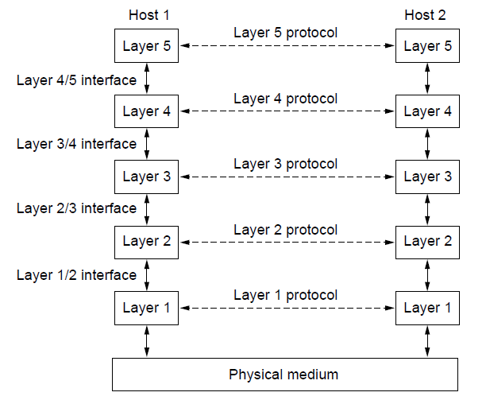
Protocol Hierarchies: Layers, protocols & interfaces

Slide 76
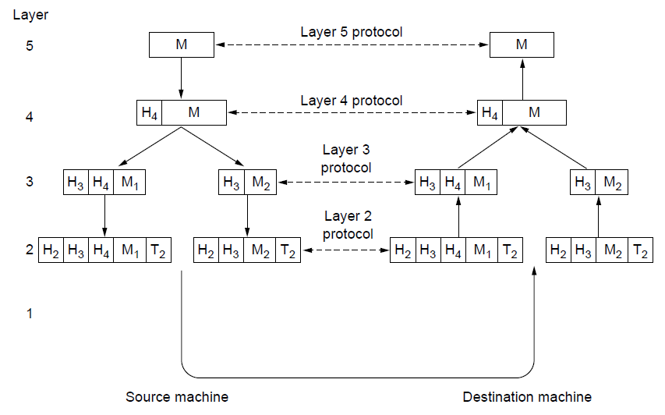
Protocol Hierarchies: virtual communication in layer 5

Slide 77
Reference Models
OSI reference model
TCP/IP reference model
Comparison of OSI and TCP/IP

Slide 78
OSI Reference Model
Principles for the seven layers of OSI Model:
Layers created for different abstractions
Each layer performs well-defined function
Function of layer chosen with definition of international standard protocols in mind
Minimize information flow across interfaces between boundaries
Number of layers optimum

Slide 79
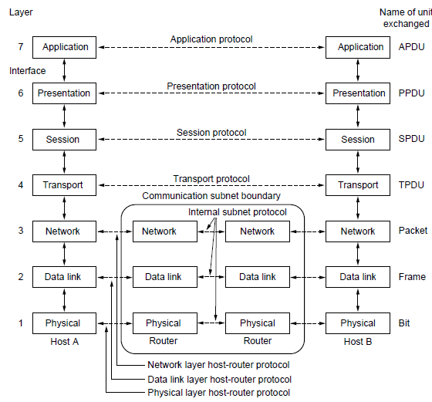
OSI Reference Model

Slide 80
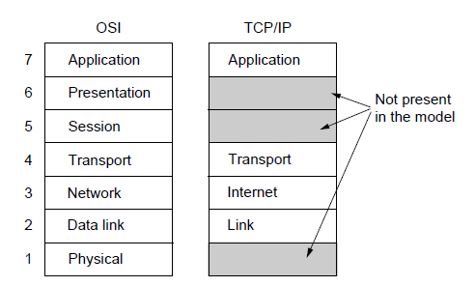
TCP/IP Reference Model

Slide 81
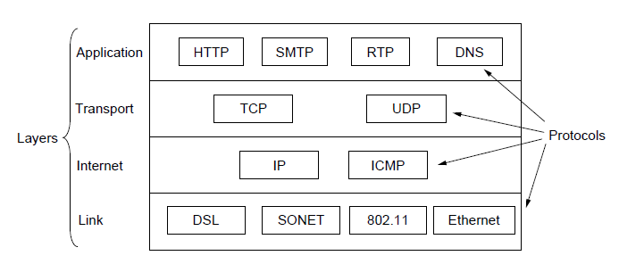
TCP/IP Reference Model: Protocols

Slide 82
Comparison of OSI & TCP/IP Reference Models
OSI(Open System Interconnection) | TCP/IP(Transmission Control Protocol / Internet Protocol)
OSI is a generic, protocol independent standard, acting as a communication gateway between the network and end user. | TCP/IP model is based on standard protocols around which the Internet has developed. It is a communication protocol, which allows connection of hosts over a network.
In OSI model the transport layer guarantees the delivery of packets. | In TCP/IP model the transport layer does not guarantees delivery of packets. Still the TCP/IP model is more reliable.
Follows vertical approach. | Follows horizontal approach.
OSI model has a separate Presentation layer and Session layer. | TCP/IP does not have a separate Presentation layer or Session layer.
Transport Layer is Connection Oriented. | Transport Layer is both Connection Oriented and Connection less.

Slide 83
Comparison of OSI & TCP/IP Reference Models
OSI(Open System Interconnection) | TCP/IP(Transmission Control Protocol / Internet Protocol)
Network Layer is both Connection Oriented and Connection less. | Network Layer is Connection less.
OSI is a reference model around which the networks are built. Generally it is used as a guidance tool. | TCP/IP model is, in a way implementation of the OSI model.
Network layer of OSI model provides both connection oriented and connectionless service. | The Network layer in TCP/IP model provides connectionless service.
Protocols are hidden in OSI model and are easily replaced as the technology changes. | In TCP/IP replacing protocol is not easy.
OSI model defines services, interfaces and protocols very clearly and makes clear distinction between them. It is protocol independent. | In TCP/IP, services, interfaces and protocols are not clearly separated. It is also protocol dependent.
It has 7 layers | It has 4 layers

Slide 84

Addresses in TCP/IP Network

Slide 85

Network Topology
Way of connection between computers, printers and other devices
Layout of the wire and devices as well as the paths used by data transmissions

Slide 86

Bus Topology
Commonly referred as a linear bus
All the devices are connected by one single cable

Slide 87


Ring Topology
A frame travels around the ring, stopping at each node
A Node wants to transmit data it adds the data as well as the destination address to the frame, which takes the data out of the frame
Single ring – all the devices on the network share a single cable
Dual ring – allows data to be sent in both directions

Slide 88


Star and Tree Topology
Star topology
Most commonly used architecture in Ethernet LANs
Extended star topology or tree topology
Significantly reduces the traffic on the wires by sending packets only to the wires of the destination host
Network devices that filter frames or packets like bridges, switches and routers

Slide 89

Mesh Topology
Connects all devices (nodes) to each other for redundancy and fault tolerance
Used in WANs to interconnect LANs and for mission critical networks like those used by banks and financial institutions
Implementation is Expensive and difficult

Slide 90

IEEE 802.2: Logical Link Control
(a) Position of LLC (b) Protocol formats

Slide 91
IEEE Standards
Ethernet: It is a LAN protocol that is used in Bus and Star topologies and implements CSMA/CD as the medium access method
Original (traditional) Ethernet developed in 1980 by three companies: Digital, Intel, Xerox (DIX).
In 1985, the Computer Society of the IEEE started a project, called Project 802, to set standards to enable intercommunication among equipment from a variety of manufacturers.
Current version is called IEEE Ethernet

Slide 92

Ethernet Frame format
FCS
FCS
Frame formats. (a) DIX Ethernet , (b) IEEE 802.3.

Slide 93

802.3 MAC frame

Slide 94
IEEE Ethernet
In IEEE 802.3 Ethernet Data link layer is split into two sublayers:
Bottom part: MAC
The frame is called IEEE 802.3
Handles framing, MAC addressing, Medium Access control
Specific implementation for each LAN protocol
Defines CSMA/CD as the access method for Ethernet LANs and Token passing method for Token Ring.
Implemented in hardware
Top part: LLC (Logical Link Control)
The subframe is called IEEE 802.2
Provides error and flow control if needed
It makes the MAC sublayer transparent
Allows interconnectivity between different LANs data link layers
Used to multiplex multiple network layer protocols in the data link layer frame
Implemented in software

Slide 95
Ethernet Provides Unreliable, connectionless Service
Ethernet data link layer protocol provides connectionless service to the network layer
No handshaking between sending and receiving adapter.
Ethernet protocol provides Unreliable service to the network layer :
Receiving adapter doesn’t send ACK or NAK to sending adapter
This means stream of datagrams passed to network layer can have gaps (missing data)
Gaps will be filled if application is using reliable transport layer protocol
Otherwise, application will see the gaps

Slide 96

Ethernet address
Six bytes = 48 bits
Flat address not hierarchical
Burned into the NIC ROM
First three bytes from left specify the vendor. Cisco 00-00-0C, 3 Com 02-60-8C and the last 24 bit should be created uniquely by the company
Destination Address can be:
Unicast: second digit from left is even (one recipient)
Multicast: Second digit from left is odd (group of stations to receive the frame – conferencing applications)
Broadcast (ALL ones) (all stations receive the frame)
Source address is always Unicast

Slide 97

Ethernet evolution through four generations

Slide 98


Categories of traditional Ethernet
<data rate><Signaling method><Max segment length or cable type>

Slide 99
IEEE 802.3 Cable Types
Name | Cable Max. | Max Cable Segment Length | Nodes /segment
10Base5 | thick coax | 500 meters | 100
10Base2 | thin coax | 185 meters | 30
10BaseT | twisted pair | 100 meters | 1
10BaseF | Fiber Optic | 2Km | 1
Toplogy
Bus
Bus
Star
Star

Slide 100

10Base5 implementation

Slide 101

10Base-T implementation

Slide 102

10Base-F implementation

Slide 103

Fast Ethernet
100 Mbps transmission rate
same frame format, media access, and collision detection rules as 10 Mbps Ethernet
can combine 10 Mbps Ethernet and Fast Ethernet on same network using a switch
media: twisted pair (CAT 5) or fiber optic cable (no coax)
Star-wire topology
Similar to 10BASE-T
CAT 3
CAT 5

Slide 104

Fast Ethernet topology

Slide 105

Fast Ethernet implementations

Slide 106

13.5 Gigabit Ethernet
Speed 1Gpbs
Minimum frame length is 512 bytes
Operates in full/half duplex modes mostly full duplex

Slide 107

Topologies of Gigabit Ethernet

Slide 108

Gigabit Ethernet implementations

Slide 109
Figure 13.23 Gigabit Ethernet implementations

Slide 110
Answer the following questions
haracteristic CSMA/CD CSMA/CA Token RingMutiple accessCarrier SenseCollision checkingAcknowledgement
Explain what might happen if two stations are accidentally assigned the same hardware address?
Why wireless LAN can not use the same CSMA/CD mechanism that Ethernet uses?
Complete given table and answer yes or no-
Characteristic | CSMA/CD | CSMA/CA | Token Ring
Multiple access
Carrier Sense
Collision checking
Acknowledgement

Slide 112
If we can extend the LAN then why we need a WAN?
How can a bridge know whether to forward frames?
Can the length of an Ethernet be increased to many segments of 500 meter each merely by adding a repeater to connect each additional segment?

Slide 113
Data Link Layer: Re-Cap
Function:
Provide service interface to the network layer
Dealing with transmission errors
Regulating data flow
Slow receivers not swamped by fast senders
Frame
info
ack
seq
kind

Slide 114
Problem of Channel Allocation
Static Channel Allocation in LANs and MANs
Dynamic Channel Allocation in LANs and MANs

Slide 115

Multiple Access Protocols

Slide 116
Random Access
In random access or contention methods, no station is superior to another station and none is assigned the control over another. No station permits, or does not permit, another station to send. At each instance, a station that has data to send uses a procedure defined by the protocol to make a decision on whether or not to send.

Slide 117

Frames in a pure ALOHA network

Slide 118

Frames in a slotted ALOHA network

Slide 119

Vulnerable period for the shaded frame

Slide 120
Answer the following question
A group of N stations share 100 Kbps slotted ALOHA channel. Each station output a 500 bits frame on an average of 5000 ms even if previous one has not been sent. What is the required value of N?

Slide 121
PURE ALOHA v/s Slotted ALOHA (2)
Pure Aloha | Slotted Aloha
Any station can transmit the data at any time. | Any station can transmit the data at the beginning of any time slot.
The time is continuous and not globally synchronized. | The time is discrete and globally synchronized.
Vulnerable time in which collision may occur = 2 x T_{t} | Vulnerable time in which collision may occur = T_{t}
Probability of successful transmission of data packet = G x e-^{2G} | Probability of successful transmission of data packet = G x e-^{G}
Maximum efficiency = 18.4% (Occurs at G = 1/2) | Maximum efficiency = 36.8% ( Occurs at G = 1)
The main advantage of pure aloha is its simplicity in implementation. | The main advantage of slotted aloha is that it reduces the number of collisions to half and doubles the efficiency of pure aloha.

Slide 122

Carrier Sense MA protocols
Protocols in which stations listen for a carrier (i.e. a transmission medium) and act accordingly, e.g. MA protocols used by LANs.
1-Persistent CSMA
When a station has data to send, it listens to the channel.
If the channel is busy, it waits until channel idle.
When the channel is idle, it transmits a frame (with probability = 1).
Propagation delay effect:
At t0, station 1 detects idle and sends a frame.
At t0+τ−ε, station 2 detects idle and sends a frame.2
At t0+τ, station 2 detects collision.

Slide 123
Carrier Sense Multiple Access (CSMA)
At t0+τ−ε+τ, station 1 detects collision.
In worst case, only about 2τ time later can station 1 detect the collision.
The longer the cable, the longer stations have to wait to be sure that there is
no collision.
Non-persistent CSMA
If the channel is busy, it waits for random period then sense the channel again.
Better channel utilization but longer delays than 1-persistent CSMA.
p-persistent CSMA (applies to slotted channel)
If the channel is idle, it transmits with prob = p (with 1-p, it defers until next slot).
If the next slot is idle again, do the same thing.

Slide 124

Persistent and Nonpersistent CSMA
Comparison of the channel utilization versus load for various random access protocols.

Slide 125

CSMA with Collision Detection
States of CSMA/CD: contention, transmission or idle

Slide 126

Collision-Free Protocols
Bit-map protocol

Slide 127

Collision-Free Protocols (2)
Binary countdown protocol: - indicates silence

Slide 128
CSMA/CA (MACA) (Multiple Access with Collision Avoidance)

